Slide 1

Sales Trends Data Analysis using Tableau
We need to analyze key indicators for our sales data to gain insights into our business performance. This analysis will involve calculating important metrics and creating various charts to visualize trends and patterns in our sales data.
Team Members Name:
Rohit G – RA2211003010509
Tharun Subramanian C – RA2211003011187

Slide 2
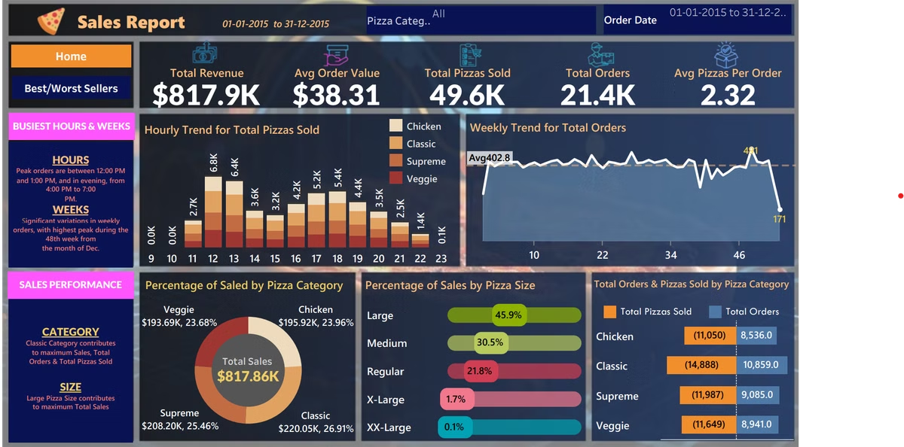
Key Performance Indicators (KPIs)
1
Total Revenue
The sum of the total price of all pizza orders.
2
Average Order Value
The average amount spent per order, calculated by dividing the total revenue by the total number of orders.
3
Total Pizzas Sold
The sum of the quantities of all pizzas sold.
4
Total Orders
The total number of orders placed.

Slide 3

Additional KPI: Average Pizzas Per Order
Definition
The average number of pizzas sold per order.
Calculation
Calculated by dividing the total number of pizzas sold by the total number of orders.
Importance
This metric helps understand customer ordering patterns and can inform inventory and staffing decisions.

Slide 4

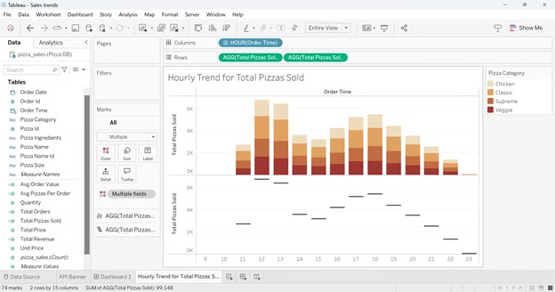
Hourly Trend for Total Pizzas Sold
1
Chart Type
Create a stacked bar chart that displays the hourly trend of total orders over a specific time period.
2
Purpose
This chart will help us identify any patterns or fluctuations in order volumes on a hourly basis.
3
Insights
Understand peak hours and potential staffing needs throughout the day.

Slide 5


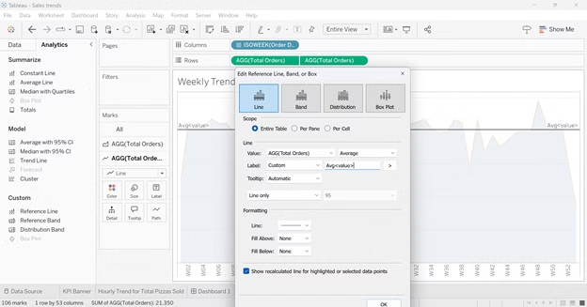


Weekly Trend for Total Orders
Chart Type
Create a line chart that illustrates the weekly trend of total orders throughout the year.
Purpose
This chart will allow us to identify peak weeks or periods of high order activity.
Insights
Understand seasonal trends and plan for high-volume periods.

Slide 6
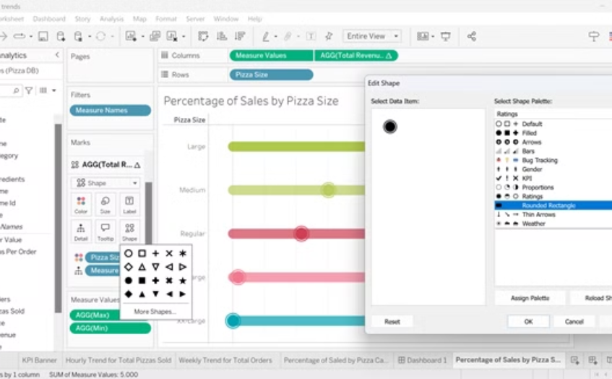
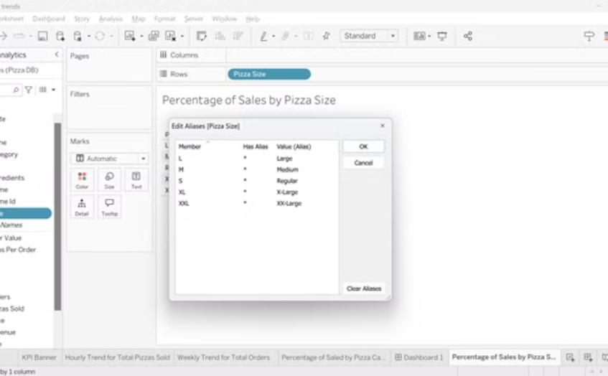
Percentage of Sales by Pizza Category and Size
Pizza Category Sales
Pizza Size Sales
Create a pie chart that shows the distribution of sales across different pizza categories. This chart will provide insights into the popularity of various pizza categories and their contribution to overall sales.
Generate a pie chart that represents the percentage of sales attributed to different pizza sizes. This chart will help us understand customer preferences for pizza sizes and their impact on sales.

Slide 7

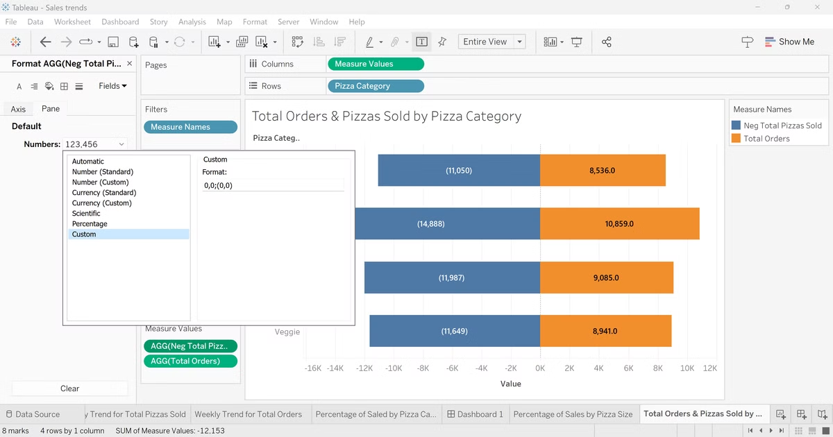
Total Pizzas Sold by Pizza Category
Chart Type
Create a funnel chart that presents the total number of pizzas sold for each pizza category.
Purpose
This chart will allow us to compare the sales performance of different pizza categories.
Insights
Identify top-performing categories and potential areas for menu optimization.

Slide 8
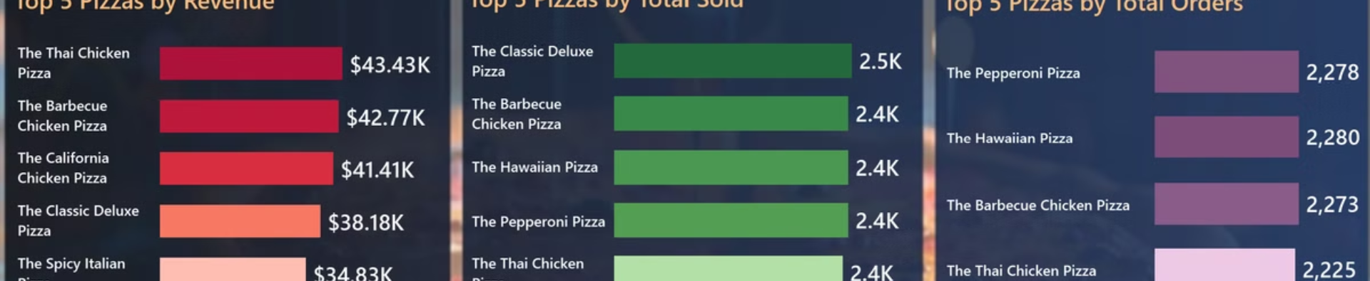
Top 5 Best Sellers
Metric
Description
Revenue
Top 5 pizzas by total sales revenue
Total Quantity
Top 5 pizzas by number of units sold
Total Orders
Top 5 pizzas by frequency of orders

Slide 9
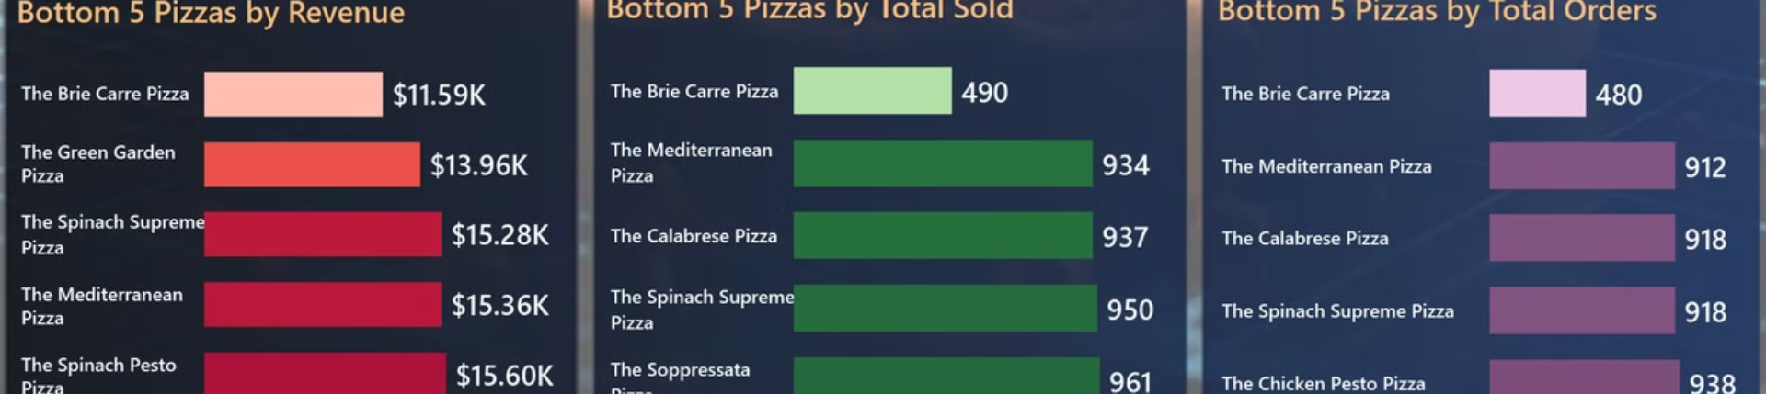



Bottom 5 Sellers
Revenue
Total Quantity
Total Orders
Bottom 5 pizzas by total sales revenue
Bottom 5 pizzas by number of units sold
Bottom 5 pizzas by frequency of orders

Slide 10
Sales Trends Analysis Using Power BI
We need to analyze key indicators for our sales data to gain insights into our business performance. This analysis will involve calculating important metrics and creating various charts to visualize trends and patterns in our sales data using Power BI.

Slide 11

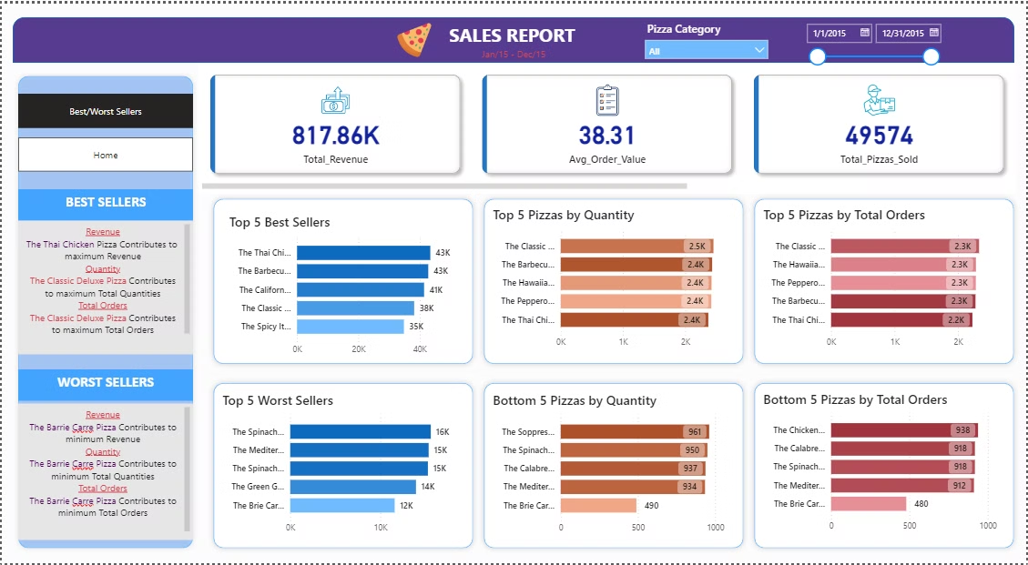
Key Performance Indicators (KPIs)
1
Total Revenue
The sum of the total price of all pizza orders.
2
Average Order Value
The average amount spent per order, calculated by dividing the total revenue by the total number of orders.
3
Total Pizzas Sold
The sum of the quantities of all pizzas sold.
4
Total Orders
The total number of orders placed.

Slide 12

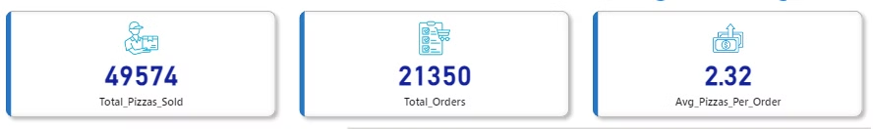
Additional KPI: Average Pizzas Per Order
Definition
The average number of pizzas sold per order.
Calculation
Calculated by dividing the total number of pizzas sold by the total number of orders.
Importance
This metric helps understand customer ordering patterns and can inform inventory and staffing decisions.

Slide 13

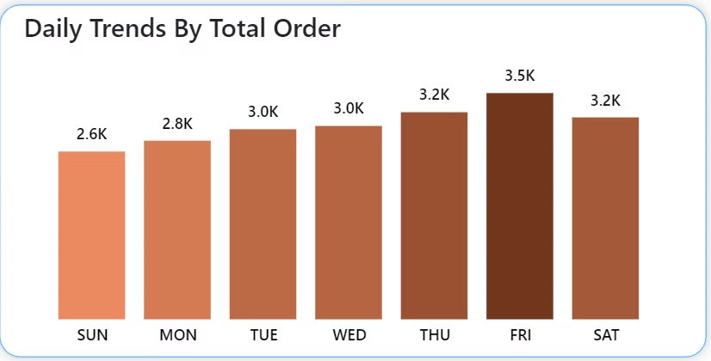
Daily Trend for Total Pizzas Sold
1
Chart Type
Create a stacked bar chart that displays the Daily trend of total orders over a time period.
2
Purpose
This chart will help us identify any patterns or fluctuations in order volumes on a Daily basis.
3
Insights
Understand peak Days and potential staffing needs throughout the day.

Slide 14

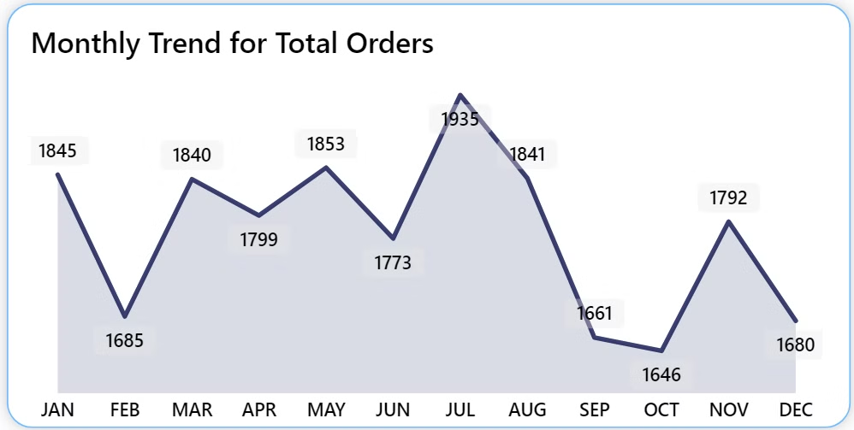
Monthly Trend for Total Orders
Chart Type
Create a area chart that illustrates the monthly trend of total orders throughout the year.
Purpose
This chart will allow us to identify peak months or periods of high order activity.
Insights
Understand seasonal trends and plan for high-volume periods.

Slide 15
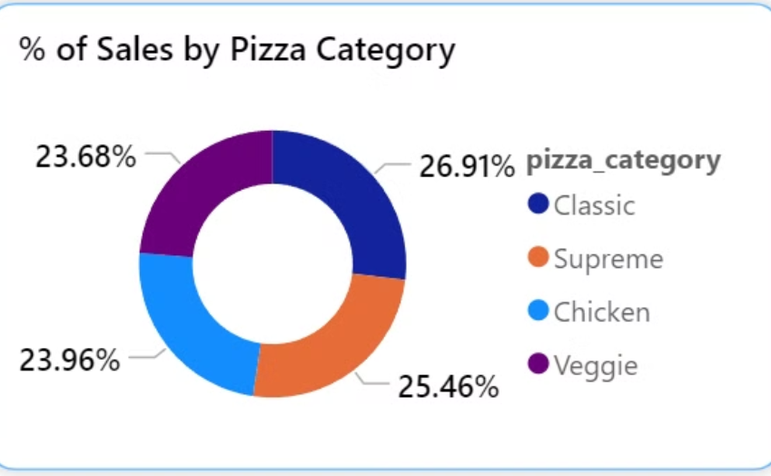
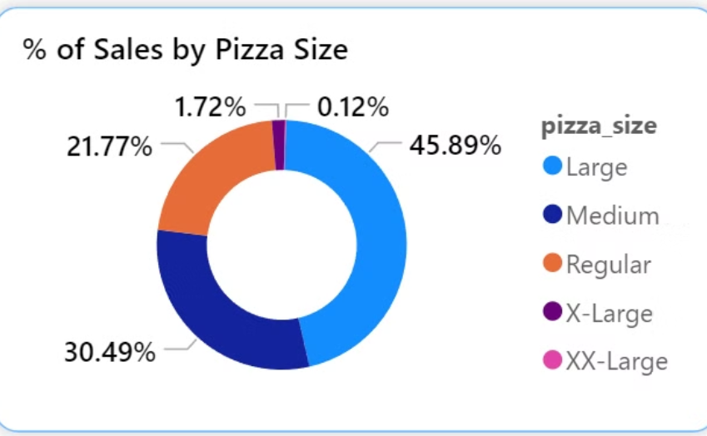
Percentage of Sales by Pizza Category and Size
Pizza Category Sales
Pizza Size Sales
Created a Donut chart that shows the distribution of sales across different pizza categories. This chart will provide insights into the popularity of various pizza categories and their contribution to overall sales.
Generated a Donut chart that represents the percentage of sales attributed to different pizza sizes. This chart will help us understand customer preferences for pizza sizes and their impact on sales.

Slide 16

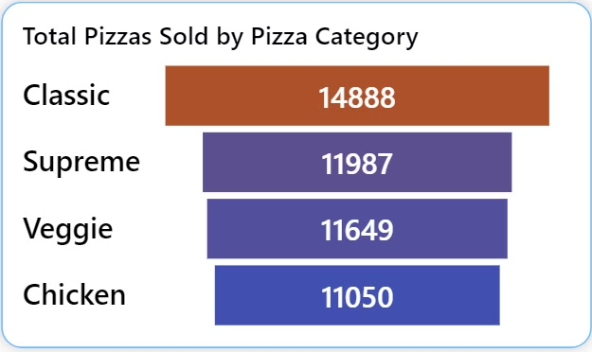
Total Pizzas Sold by Pizza Category
Chart Type
Create a funnel chart that presents the total number of pizzas sold for each pizza category.
Purpose
This chart will allow us to compare the sales performance of different pizza categories.
Insights
Identify top-performing categories and potential areas for menu optimization.

Slide 17

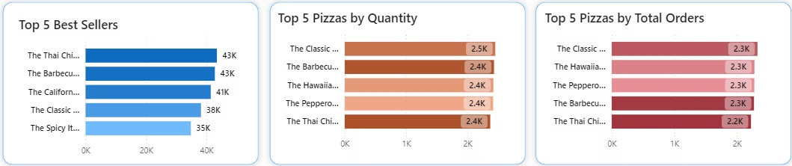
Top 5 Best Sellers
Metric
Description
Revenue
Top 5 pizzas by total sales revenue
Total Quantity
Top 5 pizzas by number of units sold
Total Orders
Top 5 pizzas by frequency of orders

Slide 18

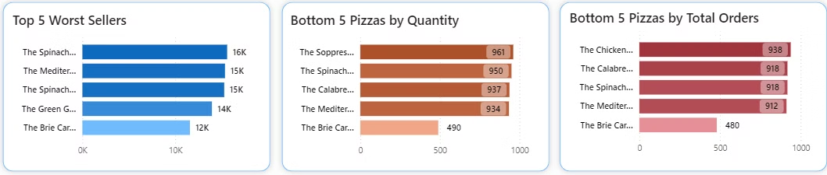
Bottom 5 Sellers
Revenue
Total Quantity
Total Orders
Bottom 5 pizzas by total sales revenue
Bottom 5 pizzas by number of units sold
Bottom 5 pizzas by frequency of orders

Slide 19

Conclusion
1
Comprehensive Analysis
By calculating these KPIs and creating these visualizations, we will gain a comprehensive understanding of our pizza sales performance.
2
Data-Driven Decisions
These insights will enable us to make data-driven decisions to improve our menu offerings, optimize pricing, and enhance overall business performance.
3
Continuous Monitoring
Regularly updating and reviewing these metrics and charts will help us stay on top of trends and quickly respond to changes in customer preferences or market conditions.

